Slide 1
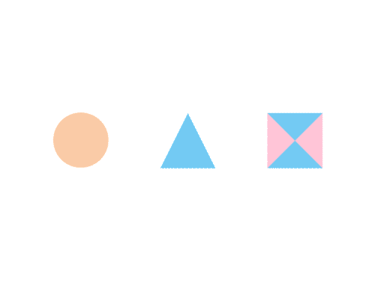

CSE 591 Text and Document Visualization 2
Ross Maciejewski
rmacieje@asu.edu

Slide 2
Today’s Topics
Move to collections of documents
Still concerned with words, phrases, and sentences
Add:
More document context
Document analysis metrics
Document meta-data
Document entities
Connections between documents
Document concepts and themes

Slide 3
Various Document Metrics
Different variables for literary analysis
Average word length
Syllables per word
Average sentence length
Percentage of nouns, verbs, adjectives
Frequencies of specific words
Hapax Legomena – number of words that occur only once
Notes:
These metrics can be used to determine if two pieces of work are similar

Slide 4
Vis
Each block represents a contiguous set of words.
Do partial overlap in blocks for a smoother appearance.

Slide 5
The Bible

Slide 6
Follow-On Work
Focus on readability metrics of documents
Multiple measures of readability
Provide quantitative measures
Features used:
Word length
Vocabulary complexity
Nominal forms
Sentence length
Sentence structure complexity
Oelke and Kiem, VAST 2010

Slide 7
Visualization and Metrics
Uses heatmap style vis (blue-readable, red-unreadable)

Slide 8
Interface

Slide 9
Their Paper (Before and After)

Slide 10
Comments from the Talk
Abstract readability is very important for academic papers.
Would be interesting to compare rejected and accepted papers.

Slide 11
Bohemian Bookshelf
Supports ‘Serendipitous browsing’
Thudt et al, CHI 2012

Slide 12
Themail
Visualize one’s email history
With whom and when has a person corresponded
What words were used
Answer questions like:
What sorts of things do I talk about with each of my email contacts?
How do my email conversation with one person differ from those with other people?
Viégas, Golder, and Donath, CHI 2006

Slide 13
Interface

Slide 14
Characteristics
Text analysis to seed visualization
Monthly and yearly words

Slide 15
Query UI

Slide 16
PaperLens
Focus on academic papers
Visualize docs metadata such as author, keywords, data, etc.
Multiple tightly-coupled views
Analytics questions
Effective in answering questions regarding:
Patterns such as frequency of authors and papers cited
Themes
Trends such as number of papers in a topic area over time
Correlations between authors, topics, and citations

Slide 17
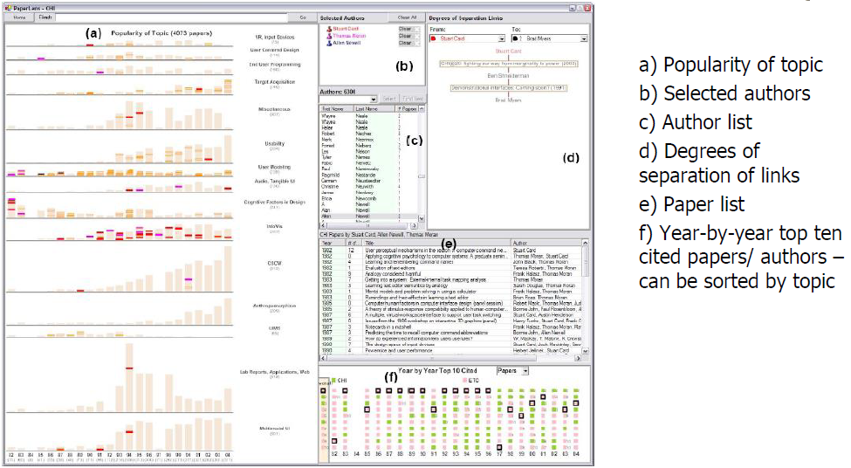
PaperLens

Slide 18
More Document Info
Highlight entities within documents
People, places, organizations
Document summaries
Document similarity and clustering
Document sentiment

Slide 19
Jigsaw
Targeting sense-making scenarios
Variety of visualizations ranging from word-specific, to entity connections, to document clusters
Primary focus is on entity-document and entity-entity connection
Search capability coupled with interactive exploration
Stasko, Gorg, and Liu, Information Visualization 2008
Gorg et al, IEEE TVCG 2013

Slide 20
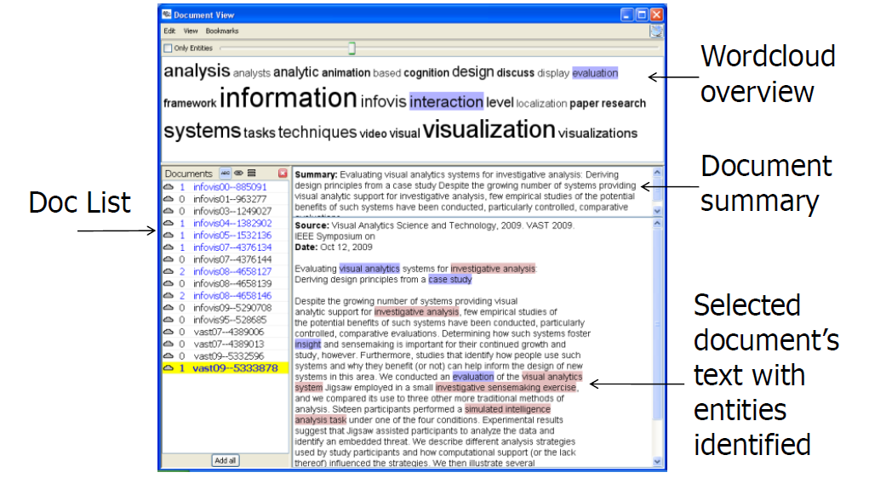
Document View

Slide 21
List View

Slide 22
Document Cluster View

Slide 23
Document Grid View

Slide 24
Calendar view

Slide 25
Demo

Slide 26
Jigsaw
More to come later…

Slide 27
FacetAtlas
Show entities and concepts and how they connect in a document collection
Visualizes both local and global patterns
Shows:
Entities
Facets – classes of entities
Relations – connections between entities
Clusters – groups of similar entities in a facet
Cao et al, TVCG (InfoVis) 2010

Slide 28
Visualization

Slide 29
Up to Higher Level
How do we present the contents, semantics, themes, etc. of the documents?
Someone may not have time to read them all
Someone just wants to understand them
Who cares?
Researchers, fraud investigators, CIA, news reporters

Slide 30
Vector Space Analysis
How does one compare the similarity of two documents
One model
Make a list of each unique word in a document
Throw out common words (a, an, the, etc.)
Make different forms the same (bake, bakes, baked)
Store count of how many times each word appeared
Alphabetize, make into a vector

Slide 31
Vector Space Analysis Cont.
Model
Want to see how closely two vectors go in same direction, inner product
Can get similarity of each document to every other one
Use a mass-spring layout algorithm to position representations of each document
Some similarities to how search engines work

Slide 32
Wiggle
Not all terms or words are equally useful
Often apply TF-IDF
Term frequency, inverse document frequency
Weight of a word goes up if it appears often in a document, but not often in the collection.

Slide 33
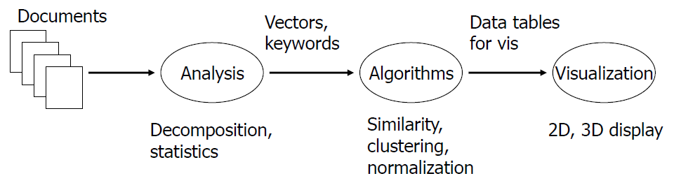
Process

Slide 34
VIBE System
Smaller sets of documents than whole library
Example: Set of 100 documents retrieved from a web search
Idea is to understand how contents of documents relate to each other
Olsen et al, Info Process & Mgmt 1993

Slide 35
Focus
Points of Interest
Terms or keywords that are of interest to user
Example: cooking, pies, apples
Want to visualize a document collection where each document’s relation to points of interest is shown
Also visualize how documents are similar or different.

Slide 36
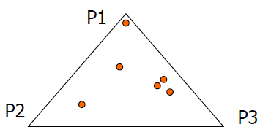
Technique
Represent points of interest as vertices on convex polygon
Documents are small points inside the polygon
How close a point is to a vertex represents how strong that term is within the document.

Slide 37
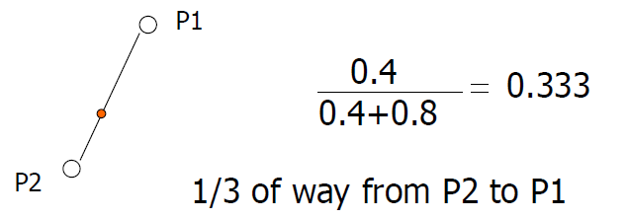
Algorithm
Example: 3 POIs
Document (P1, P2, P3) (0.4, 0.8, 0.2)
Take first two

Slide 38
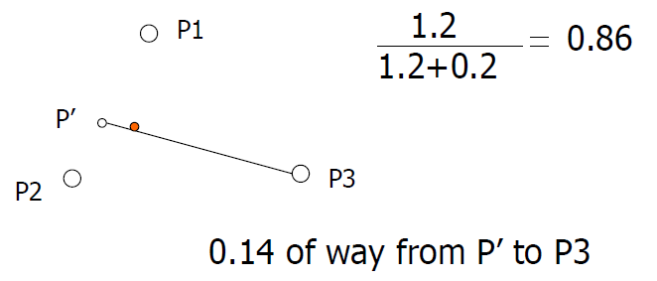
Algorithm cont.
Combine weight of first two 1.2 and make a new point, P’
Do the same thing for third point

Slide 39
Sample Visualization

Slide 40
VIBE Pros and Cons
Effectively communicates relationships
Straightforward methodology and vis are easy to follow
Can show relatively large collections
Does not show much about a document
Single items lose detail in the presentation
Starts to break down with a large number of terms

Slide 41
Visualizing Documents
VIBE presented documents with respect to a finite number of special terms
How about generalizing his?
Show large sets of documents
Any important terms within the set become key landmarks
Not restricted to convex polygon idea

Slide 42
Basic Idea
Break each document into its words
Two documents are ‘similar’ if they share many words
Use mass-spring graph-like algorithm of clustering similar documents together and dissimilar documents far apart.

Slide 43
Kohonen’s Feature Maps
AKA Self-Organizing Maps
Expresses complex, non=linear relationships between high dimensional data tiems into simple geometric relationships on a 2-d display
Uses neural network techniques
Lin, Visualization 1992

Slide 44
Map Attributes
Different, colored areas correspond to different concepts in collection
Size of area corresponds to its relative importance in set
Neighboring regions indicate commonalities in concepts
Dots in regions can represent documents

Slide 45
More Maps

Slide 46
Work at Pacific Northwest National Labs
Group has developed a number of visualization techniques for document collections
Galaxies
Themescapes
ThemeRiver
http://www.pnl.gov/infoviz
Wise et al, InfoVis 1995

Slide 47
Galaxies
Presentation of documents where similar ones cluster together.

Slide 48
Themescapes
Self-organizing maps didn’t reflect density of regions all that well – Can we improve?
Use 3D representation, and have height represent density or number of documents in region.

Slide 49
Themescape

Slide 50
WebTheme

Slide 51
Related Topic
Maps of Science
Visualize the relationships of areas of science, emerging research disciplines, the impact of particular researchers or institutions, etc.
Often use documents as the ‘input data’

Slide 52
Stanford Dissertation Browser
9,000 Stanford PhD theses
Rather than overall semantic map, you choose a focus and all update to show their relationship.
http://nlp.Stanford.edu/projects/dissertations/

Slide 53
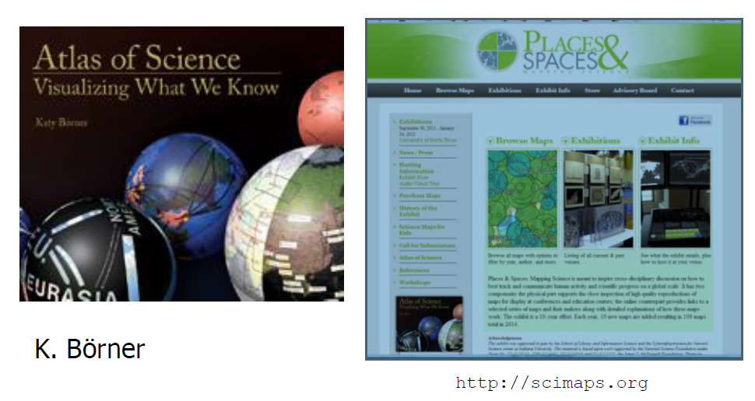
Wonderful Book and Website

Slide 54
Some Examples
Boyack and Klavans
http://scimaps.org/maps/map/map_of_scientific_pa_55/

Slide 55
Examples cont.
Boyack and Klavans
http://scimaps.org/maps/map/maps_of_science_fore_50/

Slide 56
Science Related Wikipedia Activity
Allgood, Herr, Holloway, and Boyack
http://scimaps.org/maps/map/science_related_wiki_49/

Slide 57
Temporal Issues
Semantic map gives no indication of the chronology of documents
Can we shows themes and how they rise or fall over time?

Slide 58
ThemeRiver
Havre, Hetzler, and Nowell, InfoVis 2000

Slide 59
Representation
Time flows from left to right
Each band/current is a topic or theme
Width of band is ‘strength’ of that topic in documents at the time

Slide 60
More Information
What’s in the bands?
Analysts may want to know what each band is about

Slide 61
Topic Modeling
Popular in text analysis and visualization
Latent Dirichilet Allocation
Unsupervised Learning
Produces ‘topics’ evident throughout document collection, each modeled by sets of words/terms
Describes how each document contributes to each topic

Slide 62
TIARA
Keeps basic ThemeRiver metaphor
Embed word clouds into bands to tell more about that is in each
Magnifier lens for getting more details
Uses Latent Dirichilet Allocation to do text analysis and summarization
Liu et al, CIKM 2009, KDD 2010, and VAST 2010

Slide 63
Representation

Slide 64
Features
Lens shows email senders and recievers.
Documents containing ‘cotable’

Slide 65
TextFlow
Showing how topics merge and split
Cui et al, TVCG (InfoVis) 2011

Slide 66
Text Vis Browser

Slide 67
Reading
Meirelles, Chapter 6

